Slide 1
Who was better?
Michael Jordan
Or
Shaq
Adrianna, Marissa, Kau, & Jake • 5/8/2021

Slide 2
Overview
Who was better at the game of basketball?
Please take our survey:
https://www.surveymonkey.com/r/JL6SHNL

Slide 3
Who won more games?

Slide 4
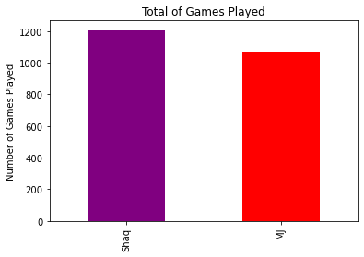
Total Games Played
Data shows that Shaq played more games in his career than MJ
Notes:
Shaq played 1,207 games
MJ played 1,072
If one were to base an assumption on just this data set, it would be easy to say Shaquille O’neal was the better player. But is longevity of career the only data you should base your opinion on ?

Slide 5
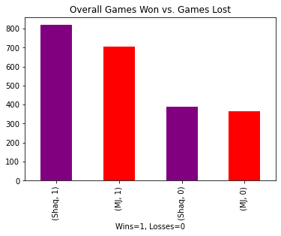
Who won or lost more games?
Shaq won 819 games and lost 388 games
MJ won 706 games and lost 366 games
Notes:
A few points that I think make sense from looking at this data set is because Shaq had a longer career, he would win more games and have the potential to lose more games. Following this logic, there would also be potential for Shaq to score more points than MJ and have more opportunity to log assists. The rest of this presentation will delve further into these possibilities.

Slide 6
Who scored more points?

Slide 7
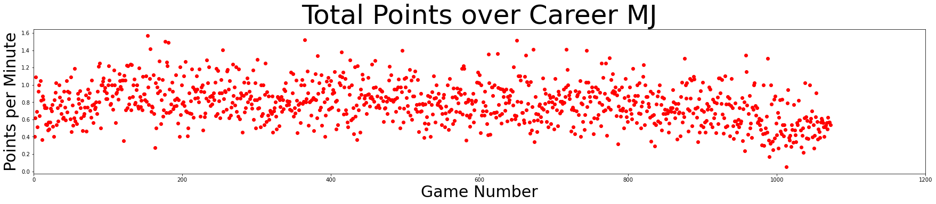
Michael Jordan Career Scores

Slide 8
Michael Jordan Career Scores
Key Insights
We see a large variance in play over time with only small hints at correlation.
It seems that Michael Jordan’s play throughout his career was anything but consistent.
The only major correlation that is seemingly visible is a small uptick early in his career and a large downtick late in his career.

Slide 9
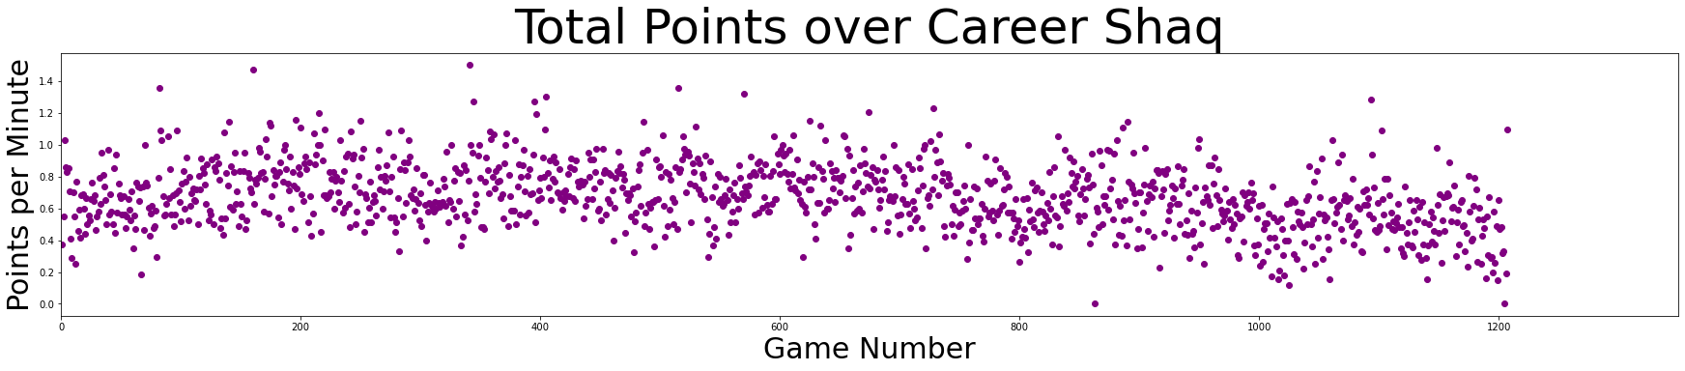
Shaq Career Scores

Slide 10
Shaq Career Scores
Key Insights
We see less variance in Shaq’s play.
Shaq appears to have less very high scoring games (outliers), with greater consistency towards his average play.
Once again we see a slide in scoring near the end of his career.

Slide 11
Who was better at assists?

Slide 12
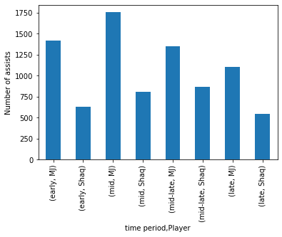
Number of Assists During Career

Slide 13
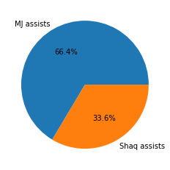
Percentage of Assists
Total Assists
This graph shows that after Michael Jordan and Shaq played the same number of games before MJ retired for good, MJ had 66.4% of the total assists between them. This also shows MJ had around twice as many assists as Shaq.

Slide 14
Change in Assists over time
Key Insights
MJ assisted the ball at higher levels than Shaq during all time periods of his career.
MJ peaked in his assist total during the second quarter (mid) of his career and steadily declined from there.
Shaq peaked in his assists total at the mid-late part of his career.
Shaq’s peak in assist total occurred later than Michael Jordan’s

Slide 15
Who was better at free throws?

Slide 16
Free Throw Comparison
T Test
A T Test was performed to make sure the data was had was statistically significant.
The p value was equal to:
1.07x10^-15
Player | Free Throw Hit Mean(%)
Michael Jordan | 82.8%
Shaq | 53.6%

Slide 17
Conclusion
Did your expectations for who was the better player hold up?
This was a narrow view at two players and far more research could be devoted to uncovering key reasons for differences in play.

Slide 18
Questions

